Slide 1
Semantic-Tableaux-Ex4.2
Dutescu Horia Ionut

Slide 2
Problem Statement
U= ¬(q Λ¬p Λr) ∨(¬p ∨¬(q Λr))

Slide 3
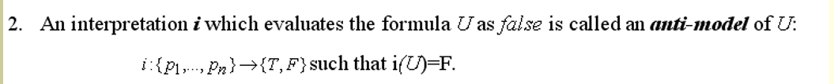
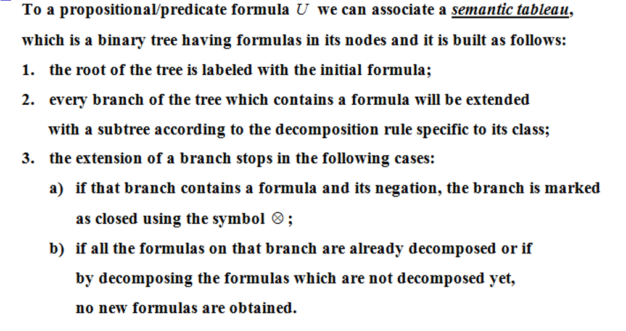
Theory:

Slide 4
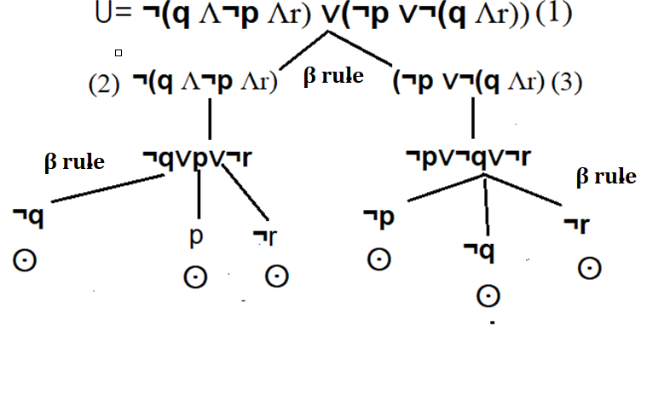
We create the semantic tableaux for U:

Slide 5
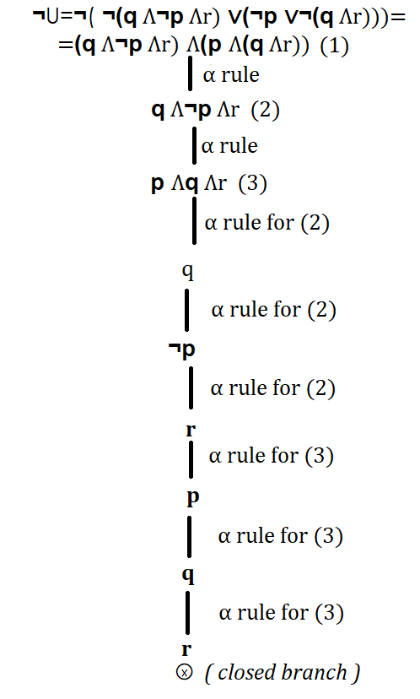
And now we create the semantic tableaux for ¬U:
And we conclude that the ¬U has only anti- models , so we deduce that the U has only models. So we have no anti-models to write for U.

Slide 6
Conclusion:
U= ¬(q Λ¬p Λr) ∨(¬p ∨¬(q Λr))
Has only models, so we don’t have any anti-model to write for it.

